Slide 1

Movie Market Analysis
BY GROUP 3

Slide 2
OUTLINE
Business Problem
Data
Methods
Results
Conclusions

Slide 3
BUSINESS PROBLEM
The company has seen all the big companies creating original video content and they want to get in on the fun. Executives have decided to create a new movie studio, but they don’t know anything about creating movies.
The team is charged with exploring what types of films are currently doing the best at the box office.
This then must be translated into actionable insights that the head of the company's new movie studio can use to help decide what type of films to create.

Slide 4
DATA
The data that was used to provide insight for the project included:
Box Office Mojo.
IMDB.
Rotten Tomatoes.
TheMovieDB.
The Numbers.
The data had various info on movies including: genres, directors, gross income, release dates, and popularity etc.

Slide 5
METHODS
Exploratory Data Analysis (EDA):
Reviewed dataset for missing values, duplicates, and outliers
Analyzed distributions of key variables (genre, rating, revenue)
T-Test:
Compared average income between varying genres, directors
Determined if observed differences were statistically significant
ANOVA (Analysis of Variance):
Tested whether average revenues varied significantly across multiple genres and also directors
Identified which genres stood out in performance
Chi-Square Test of Independence:
Assessed whether categorical variables (genre and release date) were related
Tested if the distribution of success was independent of genre
Tools Used:
Python libraries: pandas, scipy.stats, matplotlib, and seaborn

Slide 6
RESULTS

Slide 7
STUDIO VS BOX OFFICE.
We began first with looking into the studio vs box office grossing incomes.
This comparison would show us if there is a significant difference in performance of movies according to the studio which produced it showing that there are actual factors that lead to high performance of movies.
We began first with top 5 studios according to the box office performance

Slide 8
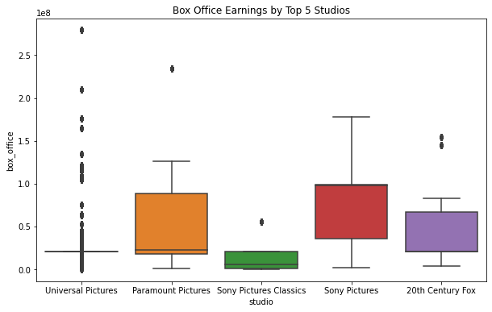
The top 5 list gave us the following studios as seen on the boxplots shown on the graph on the right.
As seen on the graph we can see that there is a visible difference in the distribution of the box office earnings of each of the top 5 studios according to no of movies produced.
This then led to a Anova test to check if there was a significance, with the hypothesis:
Null Hypothesis (H₀):
There is no significant difference in the average box office performance between the studios.
Alternative Hypothesis (H₁):
There is a significant difference in the average box office performance between at least two studios.
This suggests that the studio does play a role in determining box office success, and there is a meaningful difference in how the studios perform.

Slide 9
The output of the ANOVA test was as follows:
F-statistic: 136.53
Indicates a large difference between the means of the groups (i.e., the studios) relative to the variation within each group. This suggests that the box office performance between the studios is highly variable and that the studio factor plays a significant role in determining box office success.
P-value: 0.0
A p-value of 0.0 indicates extremely strong evidence against the null hypothesis confirms that there is a statistically significant difference in box office earnings across the different studios The null hypothesis in this case is that there is no difference in box office performance between the studios.
Conclusion
There is a significant difference in box office performance between the studios. This means that some studios are performing significantly better than others at the box office.
The studio behind a movie seems to play an important role in its box office success. Therefore, the studio factor is a major determinant of a film's financial performance.

Slide 10
TOP DIRECTORS VS BOX OFFICE
For this test we were looking into the various directors for movies.
First we looked into the top movies according to ratings which was the performance check then we looked into the directors of these movies.
Comparing this info with box office earnings as the metric and whether a movie had a top director or not to see if there was a correlation.

Slide 11
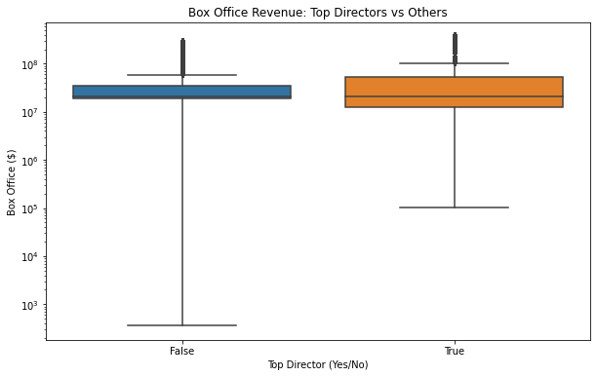
From the graph on the right we came up with the following results:
A box plot was used to compare domestic gross earnings between top directors and non-top directors.
Both groups had similar median earnings, but top directors showed a higher and more consistent performance.
The top directors group had fewer low-performing films, indicated by a smaller lower range.
Top directors also had more high-grossing outliers, suggesting a stronger potential to produce blockbuster movies.

Slide 12
We also conducted a two-tailed independent samples t-test, to check for significance the results were as follows:
T-statistic: 26.0987, P-value: 0.0000
The null hypothesis for this test was that the mean box office revenue for movies by top directors is the same as that of movies by non-top directors.
Since the p-value is essentially 0, we can confidently conclude that the box office earnings for movies directed by top directors are significantly higher than those directed by others.

Slide 13
GENRE VS BOX OFFICE
We analyzed the top 10 most common genres to see if genre influences box office success.
A box plot showed visible differences in revenue distribution across genres, with some genres displaying higher outliers and wider spreads.
A one-way ANOVA test was conducted to statistically test the differences.

Slide 14
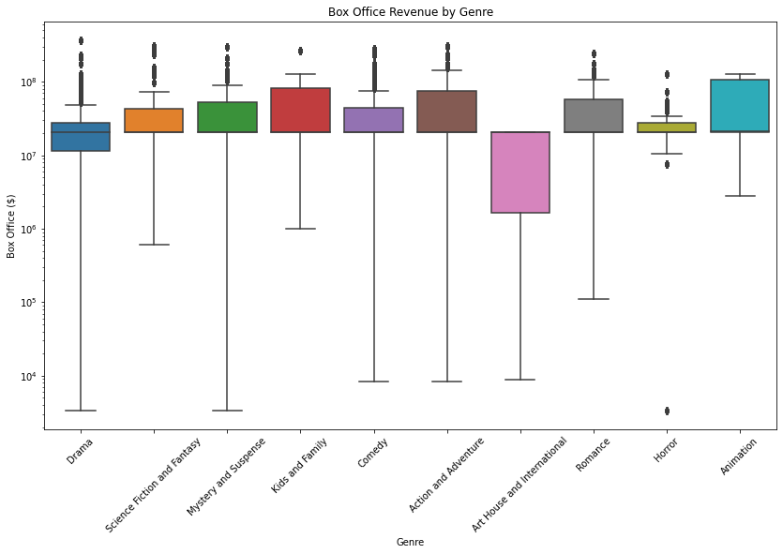
According to the graph on the left we deduced that:
This is the spread for the top 10 best performing genre according to box office.
There is a clear significant variability in spread, and recurring outliers across the nine groups.
Box office revenue varies widely by genre; some genres show more consistent or higher returns than others.

Slide 15
In addition we performed a one-way ANOVA test on the box office revenues across the top 10 genres:
We did this to check there a statistically significant difference in the mean box office revenue between the top 10 genres.
This test compares the means of all 10 genre groups to determine if at least one genre has a significantly different average box office performance.

Slide 16
The test yielded a high F-statistic (651.84) and a p-value of < 0.001.
Interpretation: We reject the null hypothesis - at least one genre has a significantly different average box office revenue.
This suggests that genre selection is a key factor in box office success.

Slide 17
GENRE VS RELEASE DATE
After getting the top 10 genres according to box office performance we looked into the release date and wanted to analyze our data with the date in mind.
First we found the mode which is the most common month that our top 10 genres are released.
This will give some info on the best month to release the specific genre that we have on our top genre list.

Slide 18
From our top genres the most common month to release the movies were analysed to be this below:
Animation December
Comedy January
Drama October
Western June
From this we looked into a hypothesis test to check if the month where a movie is released is related to its genre.
For this since both were categorical data meaning the release month and the genre we are going to use a Chi-Square Test of Independence

Slide 19
The output of the test was
Chi-square statistic: 267.66
P-value: 0.0000 (i.e., less than 0.05)
Interpretation: There is a significant relationship between movie genre and release month.
This suggests studios may strategically release certain genres during specific months to ensure and also bolster box office performance.

Slide 20
CONCLUSIONS

Slide 21
Test Recommendations
Genre matters: One-way ANOVA showed significant differences in average box office revenue across the top 10 genres (p < 0.001).
Directors influence success: T-test revealed that movies by top directors earn significantly more at the box office (p < 0.001).
Studios differ in performance: ANOVA showed that some studios consistently produce higher-grossing films (p < 0.001), which can inform strategic partnerships or hiring.
Timing is strategic: Chi-square test indicated a strong relationship between genre and release month (p < 0.001), suggesting that studios time genre releases for maximum impact (e.g., horror in October).

Slide 22
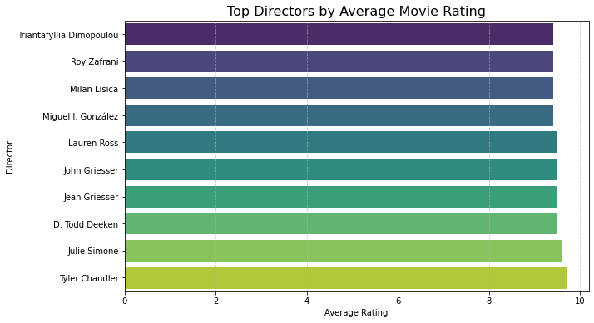
For director purposes we compiled a list of top directors according to box office performance that would be favourable to boost performance

Slide 23
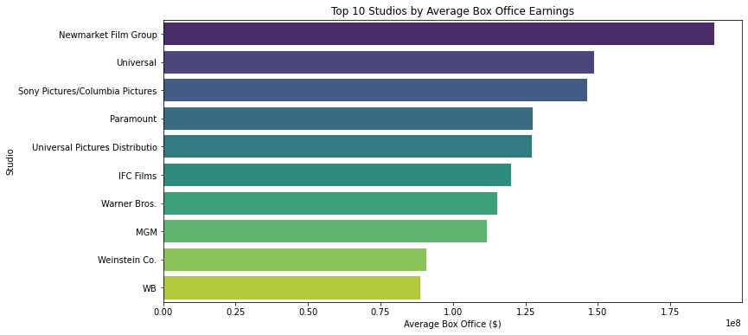
For studios that performed well we compiled a list of the top 10 studios according to internation box office gross income to aid in future collaboration

